Slide 1
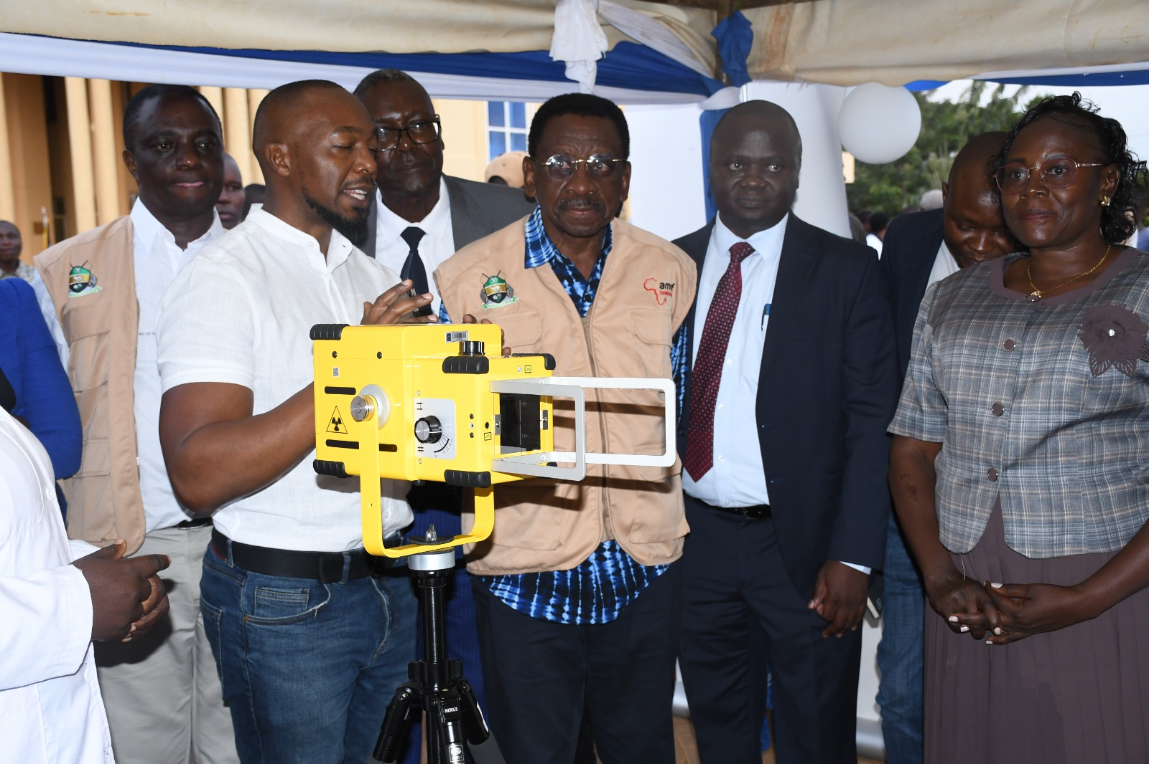
Improved TB Case Identification Using Computer Aided Diagnostic X-ray; A Study in Madiany Sub County Hospital Siaya County 2022-2024
BY;
MARGARET MAUREEN ATIENO

Slide 2
Definition of terms
Presumptive – Individuals exhibiting signs and symptoms of TB
ACF- Active case finding
TB Screening – Identifying individuals at risk of developing TB disease
Bacteriologically Confirmed TB Case – A patient from whom a biological specimen is positive by smear microscopy, culture or GeneXpert.
CAD – Computer Aided Diagnostics
AI- Artificial Intelligence

Slide 3
Background
Tuberculosis remains a public health concern globally and nationally.
Globally >1 million with TB are missed- global TB report 2023
In Kenya >40% of TB Cases are missed annually due to several reasons
When people with TB do access health services, the facility frequently does not have TB diagnostic capabilities
Rarieda Sub county did not have access to any X-ray facility
The Introduction Portable CXR with CAD AI and heat map sensitivity for TB was a hallmark in TB diagnostics in Madiany sub county hospital

Slide 4
Problem statement
Introduction of newer X-ray technology and the findings of TB prevalence survey’s demonstrate the ability of CXR to detect asymptomatic people with TB
This has led to a renewed interest in mobile campaigns to screen people for TB
CXR can improve sensitivity of the TB algorithm by identifying people who have TB but would be missed by symptom screening alone .
CXR Screening can reduce the number of diagnostic tests needed
People with normal lung findings are unlikely to have pulmonary TB

Slide 5
Justification
ACF is a proactive strategy to identify individuals with TB disease
The Portable X-ray devices with artificial intelligence (AI) are increasingly used to screen for tuberculosis (TB).
Few studies have documented their performance in Kenya
We aimed to evaluate the performance of chest X-ray (CXR) and symptom screening for active case finding of TB among the rural and fisherfolk community in Rarieda sub county

Slide 6
Objectives
Main Objective
To Asses Impact Of TB Screening by use of CAD 4TB CXR on improved TB Case identification
Specific Objectives
To characterize TB Cases screened in Time, Place and Person
To Compare TB Screening symptomatically Vs Use Of CAD4TB CXR

Slide 7
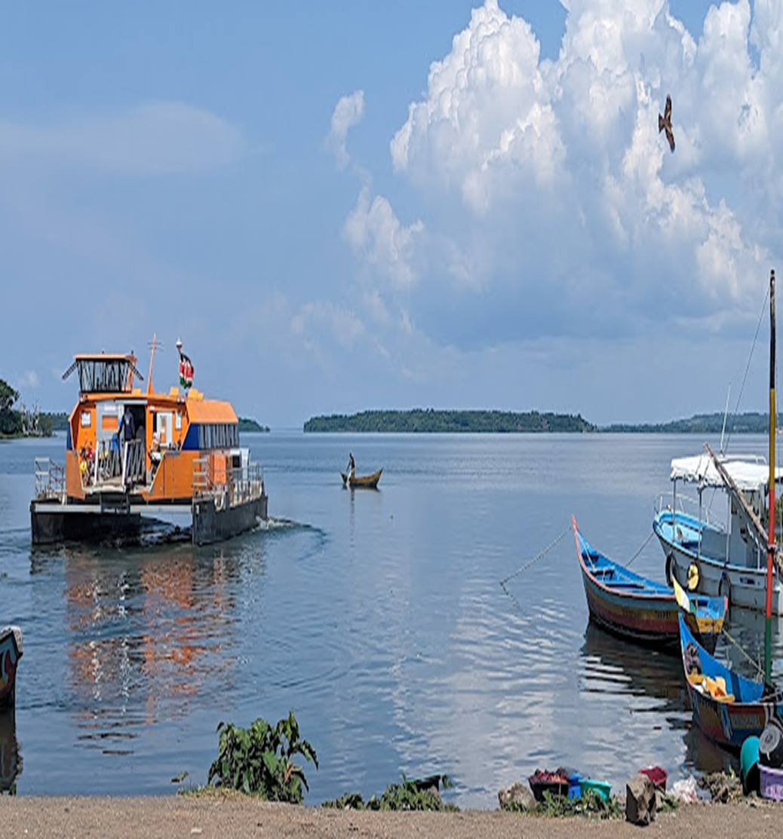
Study site
Rarieda Subcounty is in Siaya County
The area is surrounded by over 30 beaches
Rarieda Sub County has a population of 134,558
Madiany SCH in Rarieda has an estimated total population of 15,050
Rarieda is mainly a fishing community based on the area being surrounded by beaches.

Slide 8
Study design/population
The study was carried out in 25 beaches surrounding Rarieda Sub county
Madiany sub county hospital is one of the 33 facilities in Rarieda
Study population was residents and fisherfolk community
Age was Clients >15 years of age
The study period was 2022 August to 2024
Data was analyzed in Ms Excel

Slide 9
Variables assessed
Age, Sex Of the patients screened for TB
Symptomatic screening for TB
TB Screening using CAD4 TB CXR
BC TB yield from the screening

Slide 10
Sample Population
43 Outreaches
8297 Attended The Camps
5540 Eligible for screening
15 years and above

Slide 11
Characterization By Age and Gender n=5540
Age
Gender
Age Category | Number | %
15-24 | 100 | 18%
25-50 | 3214 | 58%
>50 | 2226 | 24%
Gender | Number | %
Male | 2826 | 51%
Female | 2715 | 49%

Slide 12
Symptomatic TB Screening 2022-2024 n=5540
Cases Using One symptom
Cases Using All the 4 Symptoms
4% PR

Slide 13
TB Screening Using CAD4TB Xray 2022-2024 n=5540
Cases Using CAD Score >40%-59%
Cases Using CAD Score >60%
9% PR

Slide 14
GeneXpert Results From Outreaches 2022-2024 n=1050
Presumed-1050
Number Tested-948
90%
MTB Detected-138
13%

Slide 15
GeneXpert Yield From Different CAD Scores n=1050
CAD SCORE | Presumptive | Tested | MTB Detected
>60% | 208 | 200 (96%) | 92 (44%)
>40%-59% | 316 | 296(94%) | 36 (11%)
<40% | 526 | 452 (85%) | 10 (2%)

Slide 16
TB Case Finding in Madiany SCH 2022-2024

Slide 17
DISCUSIONS
The findings demonstrate that use of symptomatic screening in outreaches had a patient proportion of 47% (using 1 symptom) while using all the 4 symptoms (53%) of the population were affected.
Using CAD 4 TB to screen for possible TB had a population of 67% symptomatic with TB Thereby reducing the possible population that would need further sputum screening
More male in their younger productive years form part of the fisherfolk community.
2016 prevalence survey indicated that men were more affected at 809 in 100,000 population

Slide 18
Limitations
Getting support for the outreaches was generally challenging
Time limitation for the fisherfolk community
Adherence issues with the TB Cases diagnosed

Slide 19
CONCLUSION
Portable CXR can be used to provide more efficient TB screening in hard-to-reach areas.
Symptom screening missed large proportions of people with bacteriologically confirmed TB.
Employing AI to read CXR can improve triaging when human readers are unavailable and can save expensive diagnostic testing costs.

Slide 20
Recommendations
Adoption of AI to read CXR can improve triaging when human readers are unavailable and can save expensive diagnostic testing costs

Slide 21
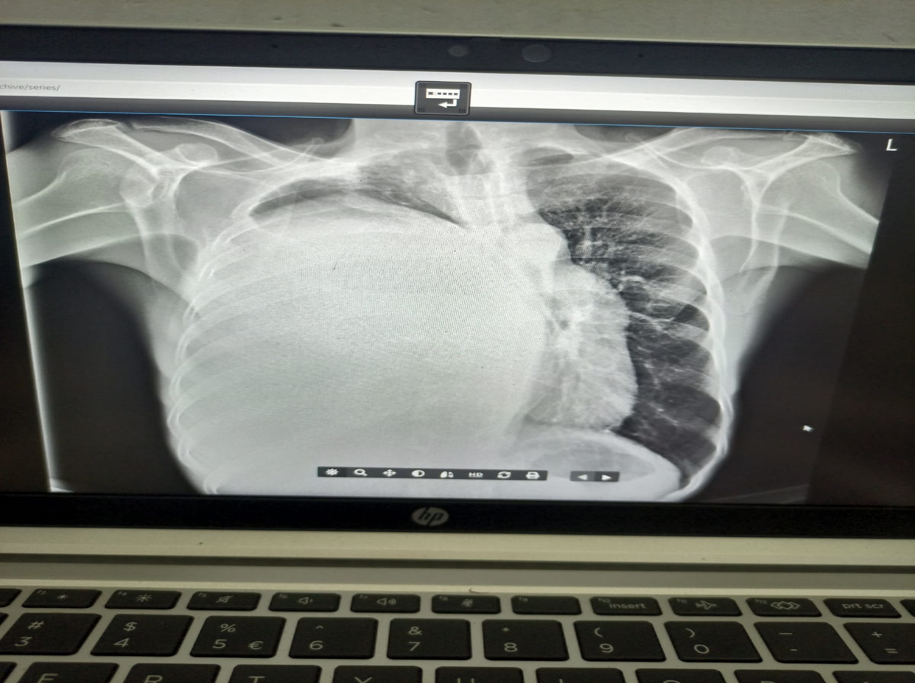
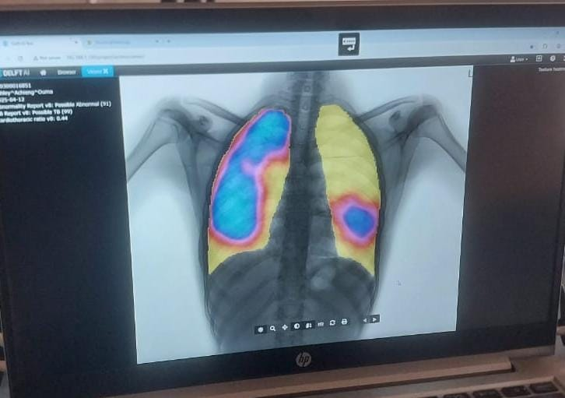
Pictorials
Abnormal CXR-Lung Mass
CXR With heat Map presumptive Of TB

Slide 22

THANK YOU

